Slide 1
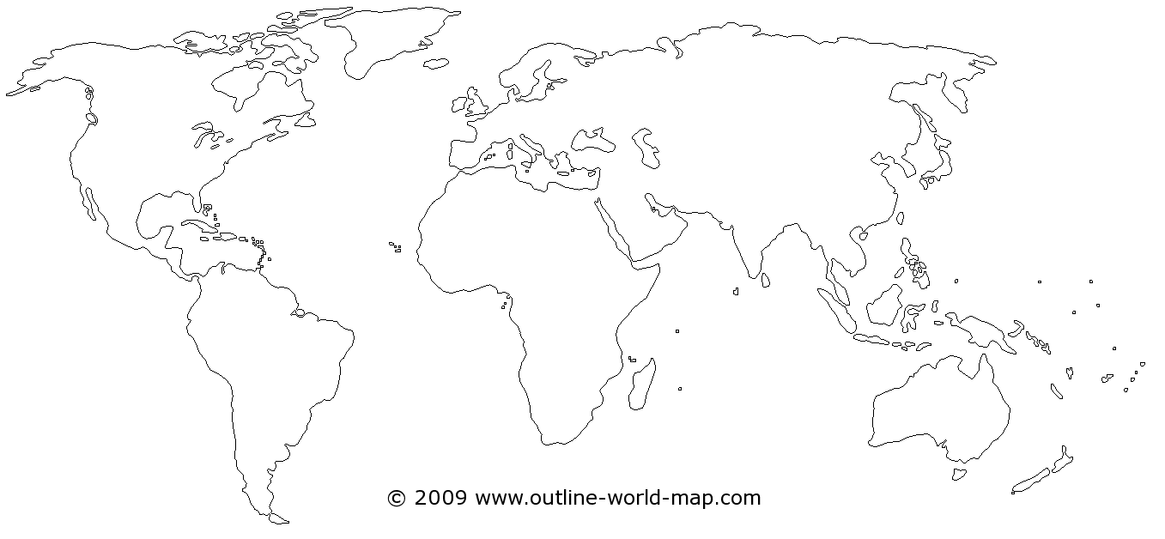
Global Studies “Pub-Quiz“ on basic global geography

Slide 2
Global Studies “Pub-Quiz“ on basic global geography
Task | Description | Time in min
1 | Outline and label the 7 continents | 5

Slide 3
Global Studies “Pub-Quiz“ on basic global geography
Task | Description | Time in min
2 | Locate the following countries in your map: Russia New-Zealand Brasil Saudi-Arabia Canada South-Africa Mexico India | 10

Slide 4
Global Studies “Pub-Quiz“ on basic global geography
Task | Description | Time in min
3 | Locate the following metropolitan areas in your map: London Mexico-City Tokyo New York Soeul Istanbul Shanghai Kairo Sao Paolo Jakarta | 15

Slide 5
Global Studies “Pub-Quiz“ on basic global geography
Task | Description | Time in min
4 | Locate the following streams and seas in your map: Atlantic Ocean Pacific Ocean Jangtsekiang Mediterranean Sea Amazon River River Nile Danube River Mississippi River Indian Ocean Mekong | 15

Slide 6
Global Studies “Pub-Quiz“ on basic global geography
Task | Description | Time in min
5 | Label the following mountains/mountain ranges in your map: Himalaya Rocky Mountains Atlas Mountains The Alps Ural Mountains Andes Mountains Mount Kilimanjaro | 10

Slide 7
Global Studies “Pub-Quiz“ on basic global geography
Task | Description | Time in min
6 | Label the following deserts in your map: Sahara Atacama Gobi Kalahari | 10

